Slide 1
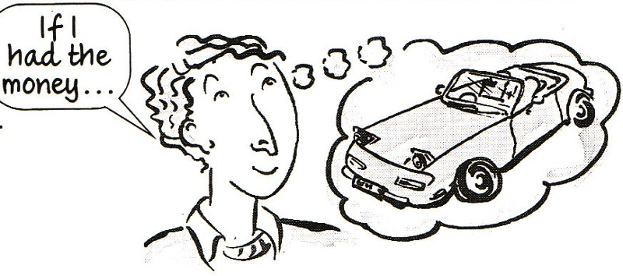
Conditionals

Slide 2
If you follow these measures, the risk of burns will be substantially reduced.
If you combined these two substances together there would be a serious risk of explosion.
If you hadn't sealed the container, the vapour would have contaminated the environment.
If you feel unwell, seek medical advice immediately.
In case of contact with eyes, rinse immediately with plenty of water.

Slide 3
Conditional sentences – Type of sentences that need a condition or a reason to happen. There are two parts in a conditional sentence:
IF MAIN
reason/condition result
Reason can be:
1) always true - ZERO CONDITIONAL
2) real and possible to happen - FIRST CONDITIONAL
3) unreal and unlikely to happen - SECOND CONDITIONAL

Slide 4
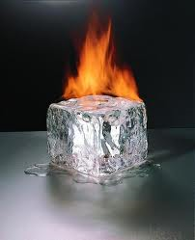
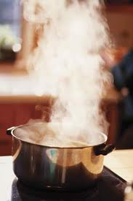
ZERO CONDITIONAL (General Truth)
If you heat ice, it …
turns to water.
If you heat water to 100 C, it…
boils.

Slide 5
ZERO CONDITIONAL (General Truth)
If-clause
If + present simple
Main clause
present simple
Used to express something which is always true. We can also use when instead of if.

Slide 6
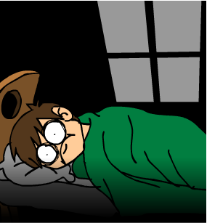

ZERO CONDITIONAL (General Truth)
(If-clause)
If I drink coffee at night,
I don’t sleep well.
(Main clause)

Slide 7
ZERO CONDITIONAL (General Truth)
Join the sentences:
If you heat water, you get green.
If you mix blue and yellow, you die.
If you don’t eat, it boils.

Slide 8
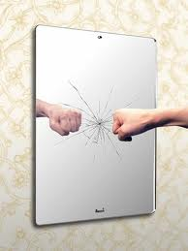

FIRST CONDITIONAL (Real / possible present)
If you break a mirror, you…
will have seven years of misfortune/ bad luck.
If it’s sunny, we…
will go for a walk.

Slide 9
FIRST CONDITIONAL (Real / possible present)
If-clause
If + present simple
Main clause
Will + verb
Used to express real or very probable situations in the present or future.

Slide 10


FIRST CONDITIONAL (Real / possible present)
If-clause
If you call me (which you might)
Main clause
I will go to the cinema with you

Slide 11
FIRST CONDITIONAL (Real / possible present)
Join the sentences:
If it is sunny, he’ll be very happy.
If you study hard, we’ll go to the park.
If we take John, you’ll pass the exam.

Slide 12
FIRST CONDITIONAL (Real / possible present)

Slide 13


Examples: If she goes abroad, she’ll spend a lot of money.
If she stays at home, she’ll be bored.
Jenifer. What will she do?
watch TV all day
not enjoy
drink tea all day
visit relatives
reed books
work in the garden
help parents
sit in the house
See a lot of
places
stay at a nice hotel
visit museums
meet a lot of people
try different food
go sightseeing
enjoy holiday.
make friends
buy souvenirs
Stay at home
Go a broad

Slide 14
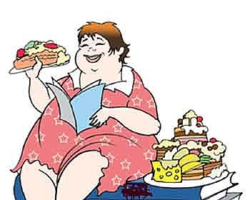
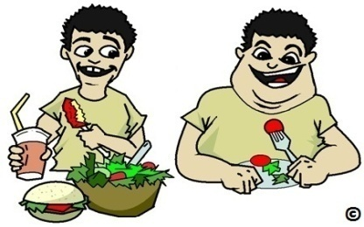




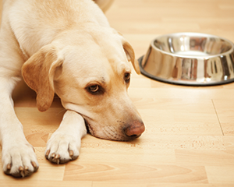
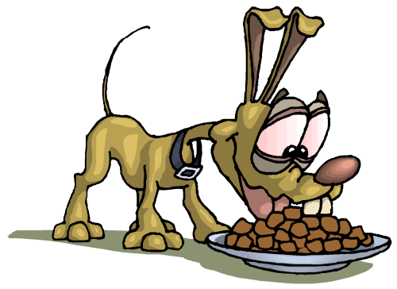
1. Eat too much
get too fat
2. Need help
phone
3. Sun-shine
go to the beach
4. Your dog-hungry
feed it

Slide 15

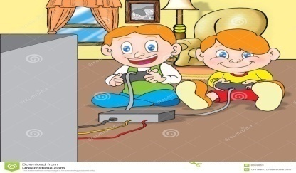
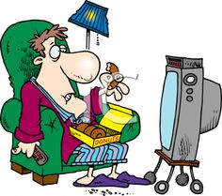



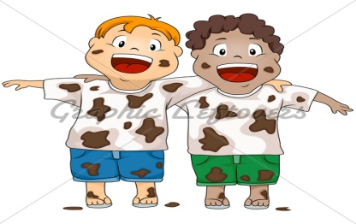
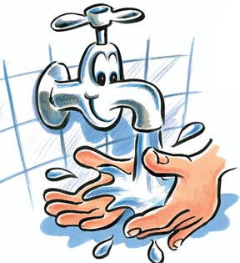
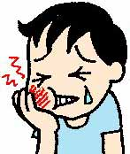
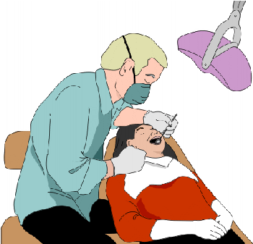
6. Rain play computer games
7.Watch TV till late tired-morning
8.Work in the garden have nice flowers
9. Be dirty wash
10.Toothache see the dentist

Slide 16
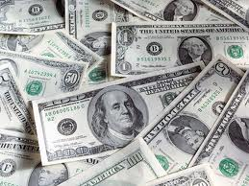
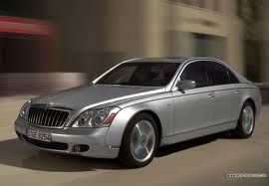

SECOND CONDITIONAL (Unreal present)
If I had lots of money, I…
would buy a car.
If dogs had wings, they…
would fly.

Slide 17
SECOND CONDITIONAL (Unreal present)
If-clause
If + past simple or past continuous
Main clause
Would + verb
Used to express hypothetical situations which are contrary to the facts in the present, and therefore, are unlikely to happen in the present or future.

Slide 18

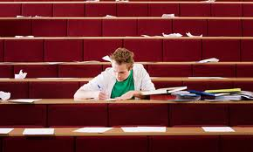
SECOND CONDITIONAL (Unreal present)
If-clause
If you studied harder (which you never do)
Main clause
you would know that (which you never do)

Slide 19
SECOND CONDITIONAL (Unreal present)
Join the sentences:
If I were rich, he wouldn’t tell it to Tom.
If you studied more, I would travel around the world.
If Tony knew that, you would pass your test.

Slide 20
Compare:

Slide 23
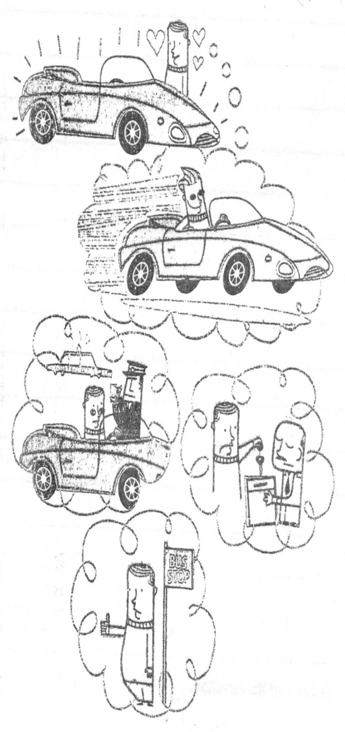
Complete the sentences with the verbs in brackets in the second conditional.
1. If I …….. the car, I …….. drive very fast. (buy/be able to)
2. If I …….. very fast, the police ……... me. (drive/stop)
3. If the police …….. me, I …….. my driving licence. (stop/lose)
4. If I …….. my driving licence, I …….. a car. (lose/not need)

Slide 26
Match two parts to form conditional sentences.
1) If these tests produce positive results, 2) If rubber is cooled to -200° C, 3) If safety measures had been followed, 4) If you want to study the files from the internet, 5) If we bought a new software package, 6) If you want to use this software package on more than one system, 7) If the goods had been sent by sea, 8) If we ran an additional test, | a) the accident would never have happened. b) download them onto your computer. e) we'd be able to do all the technical specifications in half the time. d) we could estimate the experimental error. e) they would have taken nearly two months. f) it becomes brittle and will break. g) we'll continue with clinical trials. h) you'll have to get a site licence.

Slide 27
2. Complete these sentences using the words in brackets.
1) The tests won't be continued unless ………. (there/be/better safety measures).
2) He wouldn't have been injured if ………. (he/follow/the correct procedures).
3) In the event of a collision, ………. (the airbag/inflate).
4) If all vehicles were fitted with a catalytic converter, …… (there/be/less/pollution).
5) The reaction would be speeded up if ………. (we/introduce/a catalyst).
6) If heat is applied, ………. (the substance/decompose).
7) As long as disinfectant is used, ………. (infections/not be/pass on).
8) If iron is left in contact with air and water, ………. (it/rust).

